Slide 1
The Green Economy State of the World Green Economy Coalition 2017

Slide 2
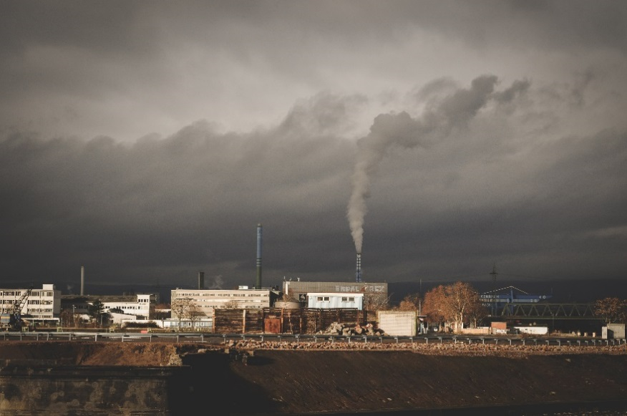
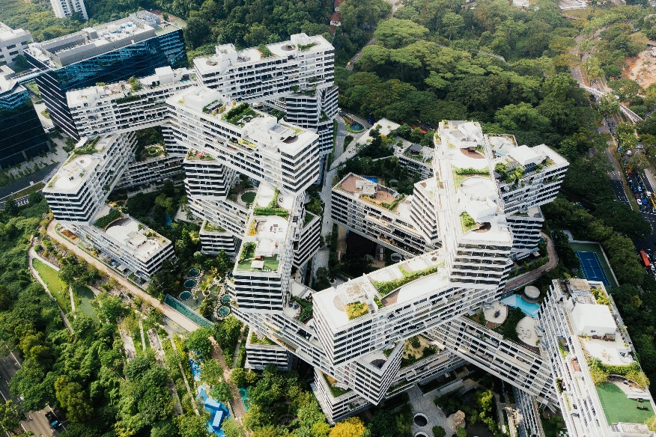
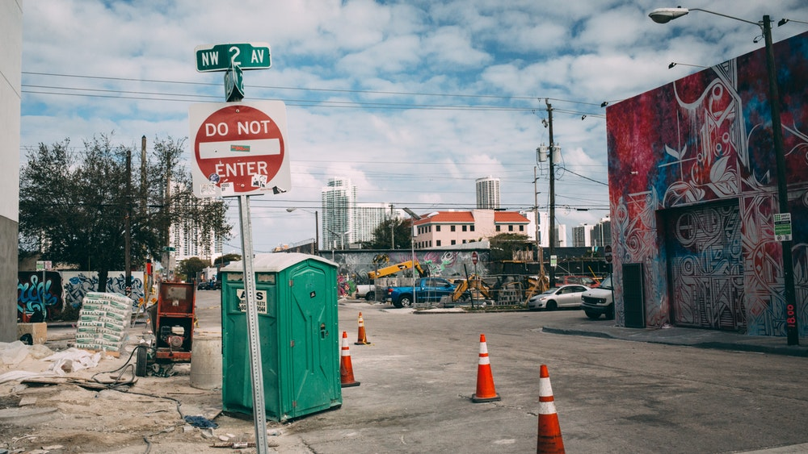
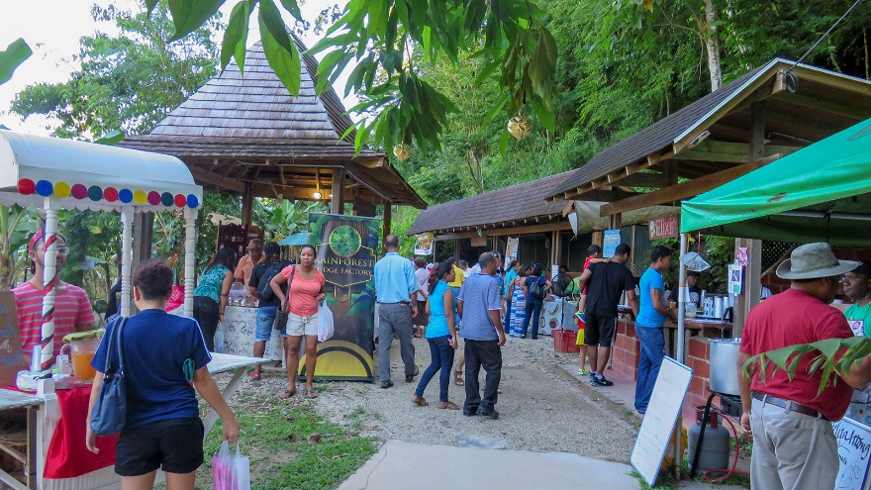
Status of the transition

Slide 3
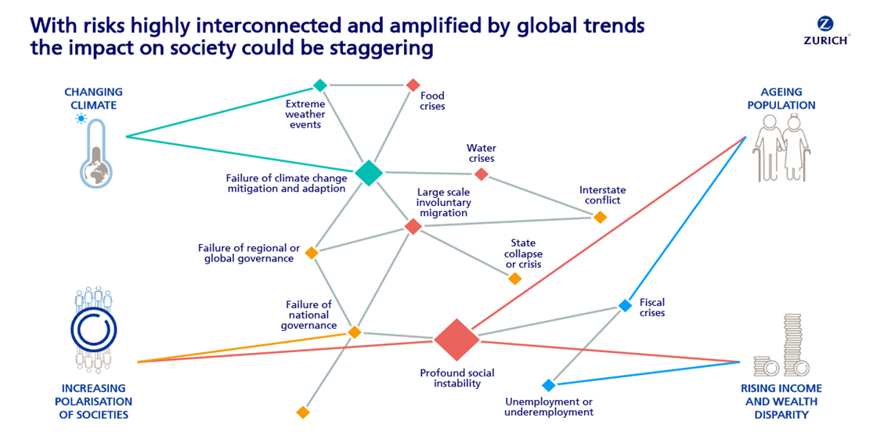
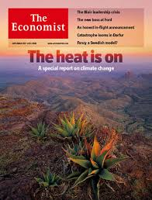
What’s driving transition?
2008 – 9: Perfect storm: financial, climate and food crisis
Risks of the brown economy: stranded assets; fluctuating prices; economic stagnation, jobless growth.
Opportunity of a green economy: new markets; stable commodity prices, job creation.

Slide 4
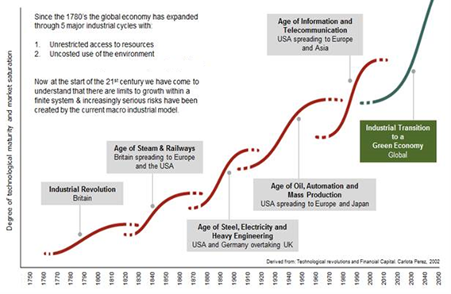
Next industrial cycle

Slide 5
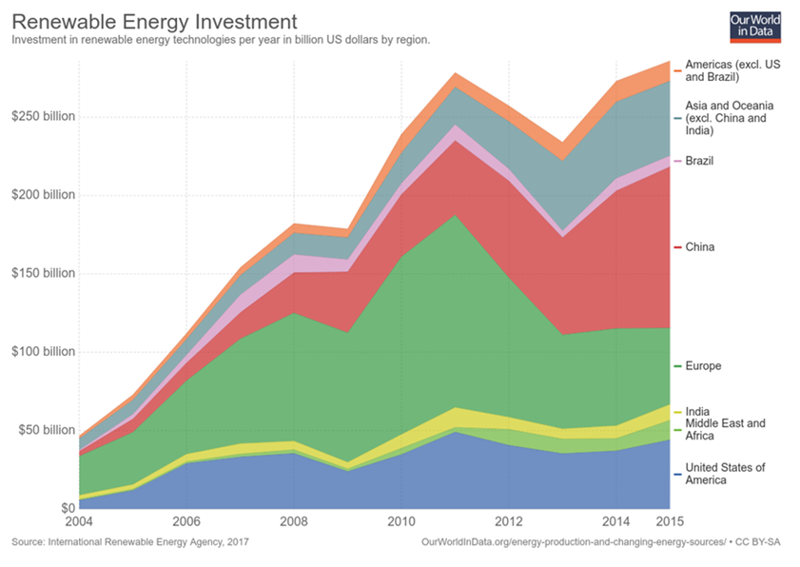
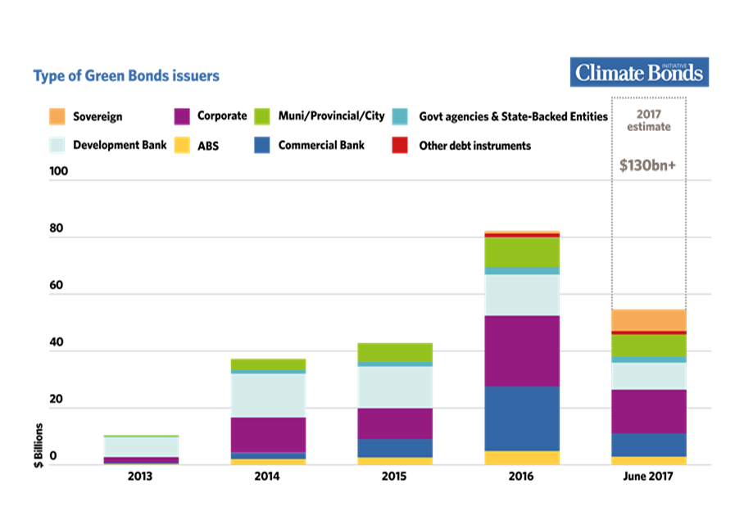
Green is growing
Energy revolution has taken off:
More investment in renewables than fossil fuels for last two years
Combustion engine
Money starting to flow:
Private investment has reached 8.13 Trillion USD since 2007
‘Green’ bonds
Central banks / sovereign wealth funds
Business/government waking up to ‘natural capital’
Word Bank WAVES
Natural Capital Protocol

Slide 6
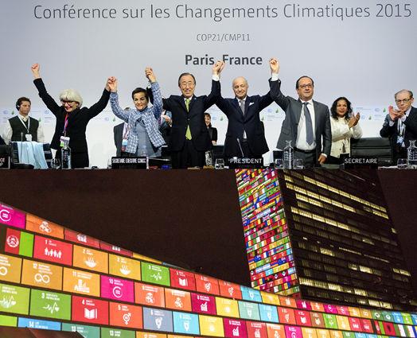
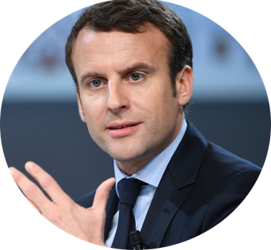
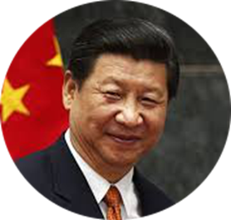
Governments taking action
65 national green growth plans
Climate change agreement
NDCs
SDGs
Annual reports on 17 actions
World Bank, UNPAGE, Global Green Growth Institute, OECD, Green Growth Knowledge Platform.
New dawn of leadership?
“Let’s Make our Planet Great Again”, President Macron.

Slide 7
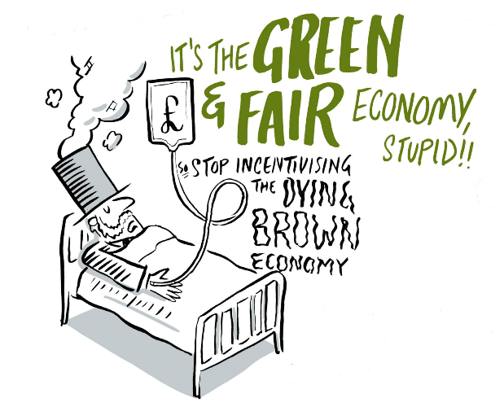
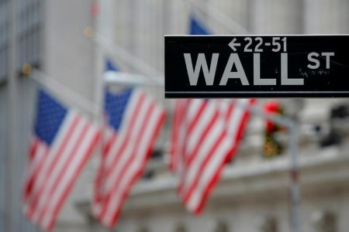
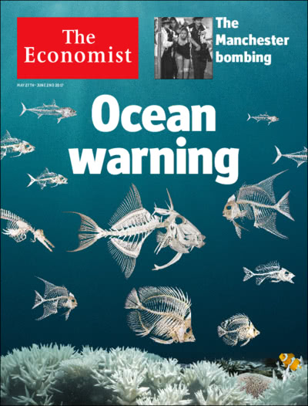
But the brown isn’t dying quietly
10 years on financial systems are unchanged
Fossil fuel subsidies, nature value of zero, banks ‘too big to fail’
Poorest not at the table
Majority of GG plans make little or no mention to poor or marginalised groups
Informal economy being forgotten
Gap getting bigger
Just 8 men own same wealth as half the world
Nature is in crisis
60% of our ecosystems are degraded.
Facing a mass extinction in biodiversity

Slide 8
GEC Vision and Goal
VISION: Prosperity for all within one planet limits
GOAL: To accelerate the transition to a green, fair and inclusive economy
CONNECT: We make bridges between business, civil society, government and people. We stimulate debate, dissent and dialogue.
COMMUNICATE: We tell the stories of change. We track the transition. We bust economic myths.
INFLUENCE: We champion the voice of the excluded. We challenge the status quo. We hold decision makers to account.

Slide 9
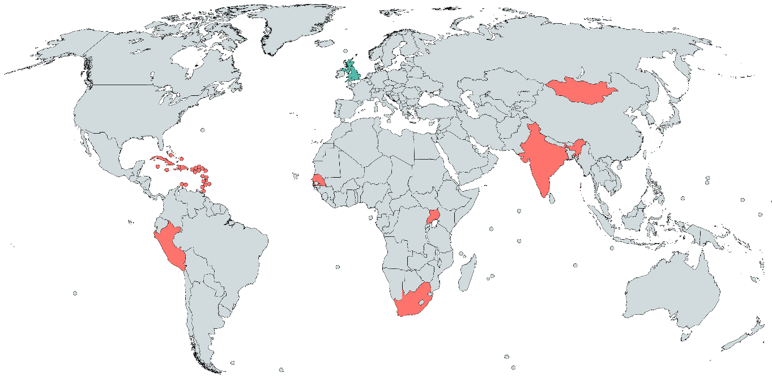
Who are we?
Where are we working?

Slide 10
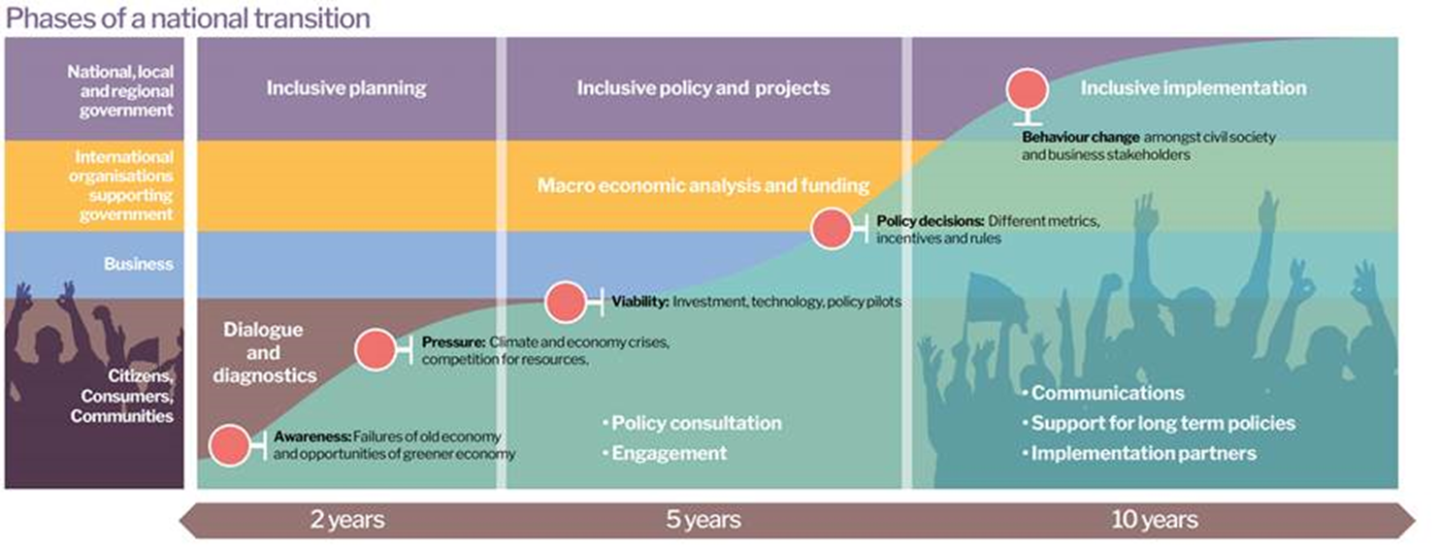
What makes us different?
Our Voice:
Diverse perspectives - poor people, workers, environmental organisations, faith groups, SMEs.
Our Mission:
We insist that this transition benefits people, particularly the poorest, and that it is guided by ecological limits. This transition must be green and fair.
Our Model:
Economic reform is too big to be tackled alone. We are new type of institution that wires together multiple organisations into shared positions and collective action.
Text etc

Slide 11
GEC strategy
Three Core Activities
Five Themes of change
Collectively Influencing
Building coherence
Mobilising through dialogue
Measuring and governing
Tackling inequality
Valuing nature
Reforming financial systems
Greening economic sectors
Green Economy Coalition network
Secretariat and Steering Group

Slide 12
In 2016 we said…
By 2020 we will mainstream the global green economy concept ensuring it means an economy that reduces inequality and poverty, increases the inclusion of all stakeholders and respects environmental limits.
By 2018 we will have established understanding that the transition to a green economy is underway, desirable and good value; and that the prize is one of economic resilience, prosperous communities and reduced environmental risks.
By 2018, we will have supported inclusive civil society movements in at least 7 developing countries and 3 regions have the capacity to support the development and implementation of green economy policies at national, regional and international levels.
By 2018, civil society, small businesses, policy makers and researchers are working closely together to implement changes to policies, practice and legislation to support just transitions to green economies.
By 2020, we will have influenced key global institutions so that transformative enabling policy on 5 areas of green economy are emerging. Those five areas are: adoption of new measures of economic performance, finance sector development to support greater green economy investment, improved sector transitions with a particular focus on small and medium sized enterprises (SMEs), policy on economic democracy and fairness, economic tools and policy to support healthy natural world.
By 2020, the GEC network will be 100 collaborating organisations, with a secretariat of 10 people, fully funded projects and core.
By 2018 we will have developed our core funding to cover new emergent areas and projects.

Slide 13
Local to global
Local: Green economy that speaks to peoples different concerns and daily lives around the world.
Global: Green economy policies that can be championed internationally and found a transition to prosperity for all.
The GEC challenge is to bridge the two.

Slide 14
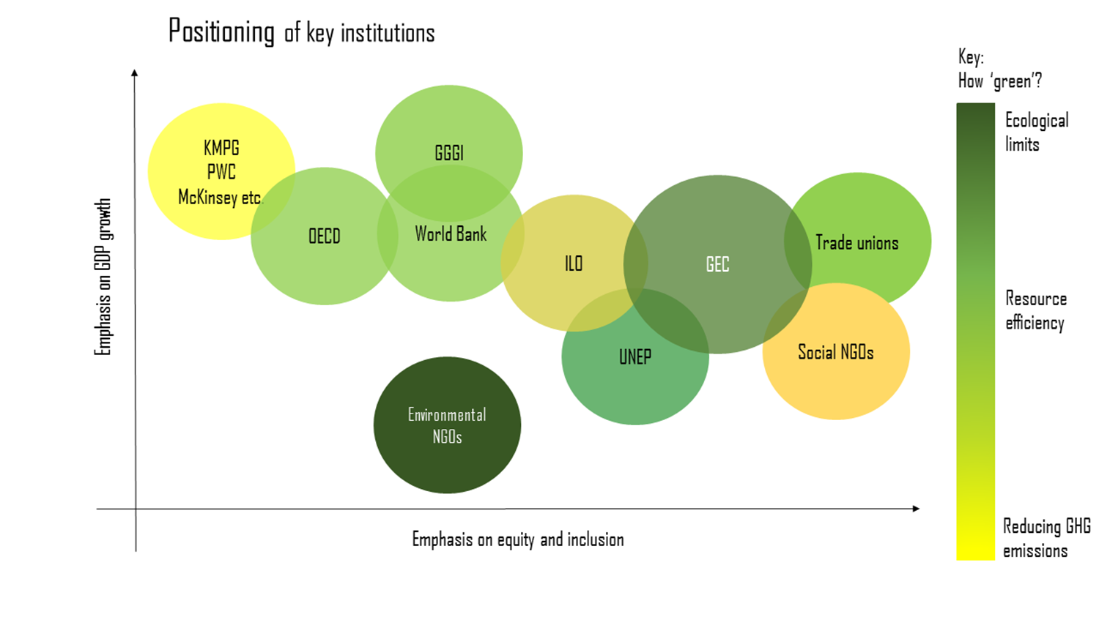

Slide 15
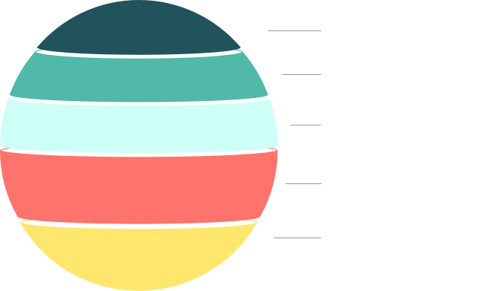
Our five themes
Measuring & governing
Reforming financial systems
Greening economic sectors
Tackling inequality
Valuing nature

Slide 16
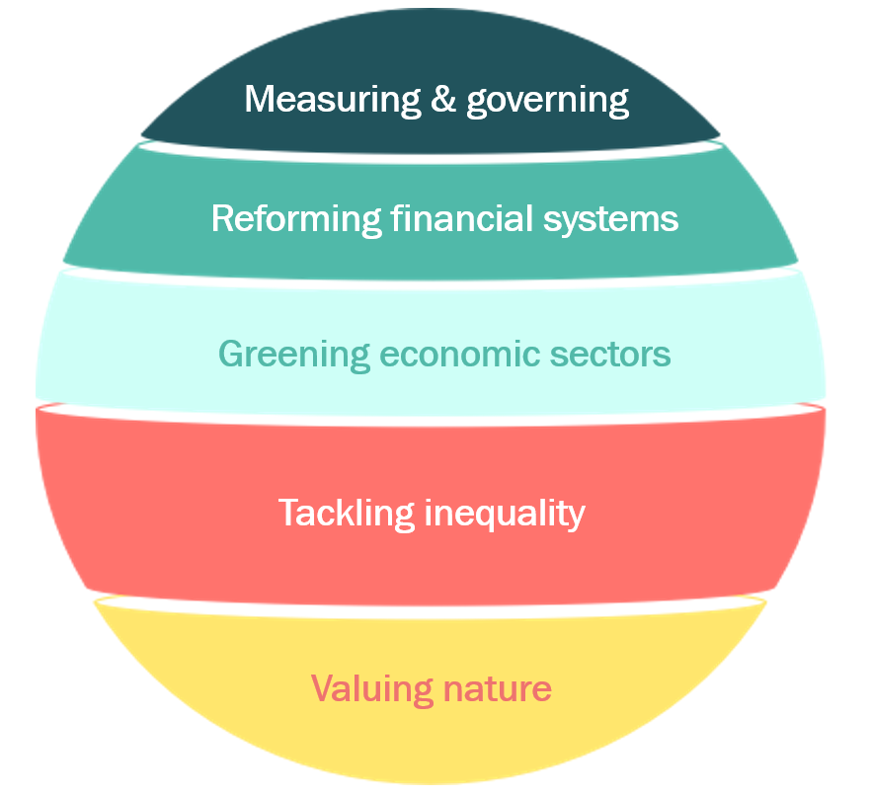
Grounding our themes
5 table groups – 1 for each theme
Question: ‘What kind of global agenda on [this theme] would have impact in your country/community?’ (What issues, what policies, what narrative… What would help you do what you want to do on green economy?)

Slide 17
Thank you. Green Economy Coalition 2017

