Slide 1
Local Green Enterprises
Delivering integrated poverty-environment-climate solutions for the SDGs
POVERTY-ENVIRONMENT PARTNERSHIP (PEP) SESSION
2 NOVEMBER 2017

Slide 2
OVERVIEW
INTRODUCTION
Background and objectives of the PEP Working Paper
THE ‘LOCAL’ OPPORTUNITY
The transformative potential of local green enterprises to deliver poverty, environment and climate solutions for the SDGs
ENABLING LOCAL SOLUTIONS
Unlocking the transformative potential of local green enterprise solutions – a ‘systems’ approach
SCALING UP IMPACT
Local Green Enterprises 2030 – towards a shared vision and global action agenda

Slide 3
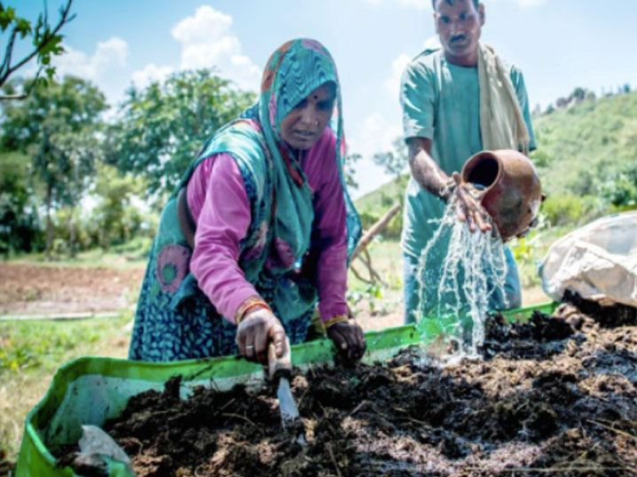
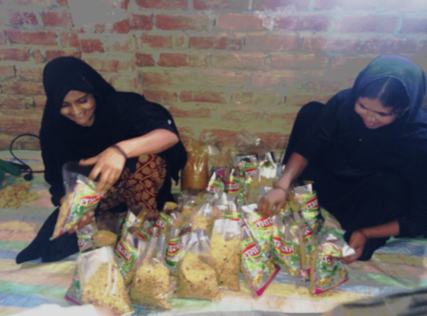
“Getting to Zero” - poverty, environment and climate call to action
‘GETTING TO ZERO’ on poverty, environment and climate —a unifying vision and call to action. The Poverty-Environment Partnership (PEP) was established after the 2002 World Summit on Sustainable Development as an informal network of like-minded organizations committed to ending extreme poverty while sustaining the environment.
From global vision to local action - Scaling up local p-e-c solutions
Local green enterprises (LGEs) have demonstrated their potential to deliver integrated poverty-environment- climate solutions that meet today’s development challenges and can accelerate the transition to fair, green and resilient economies
Notes:
“zero extreme poverty, zero net loss of natural assets and zero net climate emissions”

Slide 4
Objectives of the Working Paper
Document evidence on the transformative potential of LGEs to deliver integrated poverty-environment-climate solutions and accelerate the transition to inclusive and resilient green economies
Identify key policy, regulatory, market and institutional barriers to LGE development and scaling
Propose framework for a country-driven ‘systems’ approach to more effectively supporting and scaling up LGE solutions— drawing on case study examples of local enterprise ‘ecosystems’ and financing and partnership models that have worked to support the growth and sustainability of LGEs;
Catalyze a broader effort to forge a shared vision and global action agenda to better support and more effectively scale up LGE solutions for the SDGs

Slide 5
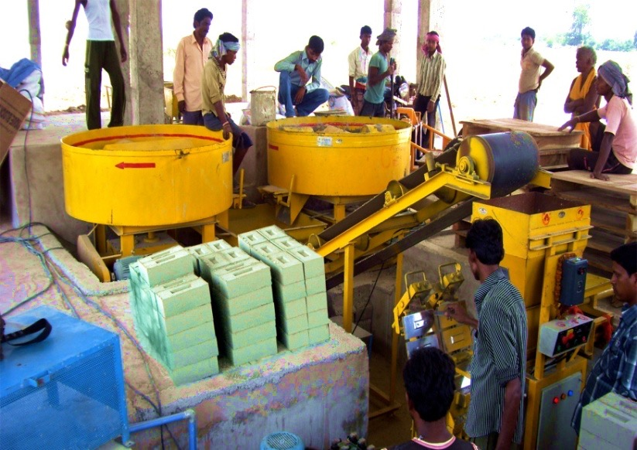
THE ‘LOCAL’ OPPORTUNITY: Defining Local Green Enterprises
Small and micro enterprises that generate a mix of economic, social and environmental benefits, to meet today’s rural development challenges and accelerate the transition to inclusive and resilient green economies
Enterprises: Formal and informal micro and small enterprises engaged in sustainable production and service sectors
Aggregators: These group based or individually run entrepreneurial endeavors bridge critical gap in value chains by connecting LGEs to high end markets through aggregation of their products/services
Policies/Programmes: Any policy initiatives that are programmed to a. build the LGE ecosystem (including technology finance, market and capacity building) or b. fiscal and monetary incentives (tax rebates, subsidies) to augment growth of LGEs
ENTERPRISES
 | Medium Enterprise | Small Enterprise | Micro Enterprise
Employees* | 50 – 249 employees | 10 – 49 employees | Less than 10 employees
Turnover | USD 5 million – USD 10 million | USD 50,000 – USD 5 million | Less than USD 50,000
Based on various estimates of IFC using various country indicators

Slide 6
THE ‘LOCAL’ OPPORTUNITY : LGEs as drivers of transformational change
Economic Benefits
Local green enterprises bring resilience, innovation, and value addition in developed and developing economies
EU: 99 % of all enterprises
Malaysia : 32 percent to Gross Domestic Product, 56.4 percent to employment opportunities
India: 39% of the manufacturing output and around 33% of the total export of the country
South Africa: 91% of the formal business entities, contributing to about 51 and 57% of GDP, providing almost 60% of employment
Social Benefits
Play a major role in creating jobs for the poor and the marginalized
High correlation between the degree of poverty hunger, unemployment, standard of living and the degree of vibrancy country’s SMEs.
A high percentage of micro and small enterprises are owned by women in South Africa and Mexico
Resilience and adaptation benefits
Clusters of small businesses build more diverse economic model versus big businesses
Prevent locking in of capital in high impact projects – lower impact on local environment
Ecosystem based enterprises promote more efficient and resourceful use of local enterprises

Slide 7
ENABLING LOCAL SOLUTIONS – The Barriers
Barriers to local green enterprise development and impact
Limited capacities, knowledge and information of aspiring entrepreneurs:
Despite the presence of entrepreneurial skills, poor access to training systems, information and low ability to take risks minimizes entrepreneurship development
Access to business support services:
Lack of access to technology solutions, finance, capacity building and marketing solutions. MSMEs in developing countries face an estimated financing gap of $2.1 to $2.6 trillion, which is equivalent to 30 to 36 per cent of current outstanding MSME credit.
Lack of regulatory support:
Inadequate infrastructure, policy frameworks, and social capital to boost MSME growth

Slide 8
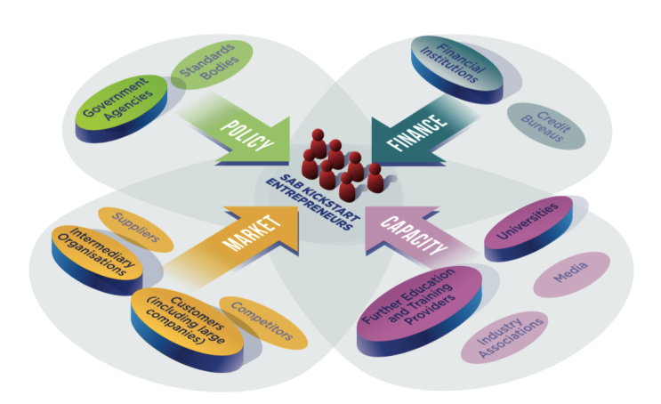
ENABLING LOCAL SOLUTIONS – a systems integrated approach
Enabling conditions for local green enterprise innovation and growth
Facilitating learning and knowledge sharing (Practice to Policy): Targeted research, monitoring and analysis to better quantify the benefits of local enterprise solutions
Equitable access to finance: A national/central finance platform that enhances local access to the various available sources and forms of domestic (public/private) and international finance in a more coherent and integrated manner, including environmental finance
Enterprise support services:
Role of aggregators: To scale up enterprises, it needs systemic availability of services – technology, finance and capacity needs, to establish new LGEs and service the running ones
Role of platforms: A clearinghouse for support services to ensure that technical inputs and services including capacity development—are accessible and coordinated
Supportive policy environment for LGEs. A targeted policy reform agenda that identifies the most urgent policy shifts and fiscal reforms necessary to support local enterprise development and promote scaling of green and inclusive enterprises

Slide 9
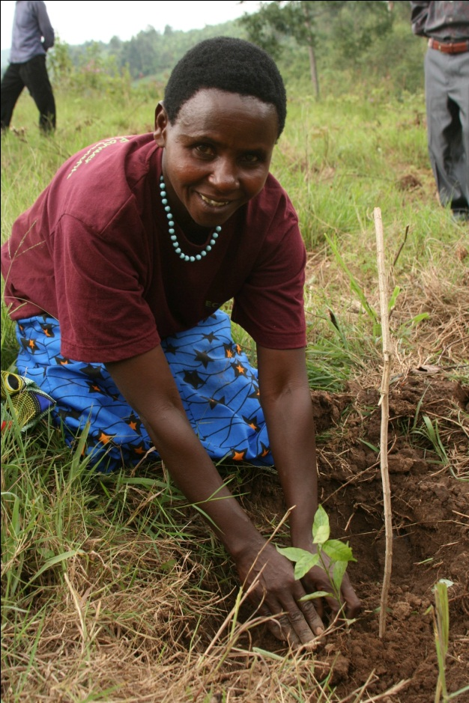
CASE STUDY: ECOTRUST, Uganda
Market solution that reduces unsustainable exploitation of forest resources
Plan Vivo System (www.planvivo.org) (a set of guidelines, procedures and standards representing a tried and tested system for generating carbon offsets) is used whilst promoting sustainable land-use and improving livelihoods. The carbon credits generated by the project are sold on the voluntary market.
The programme started in 2003 with 33 farmers in Bushenyi District and currently has over 6,000 farmers in ten different districts registered into the project, and over 6000 hectares under improved land-management across four landscapes.
Tetra Pak, UK committed to purchasing the credits to offset its carbon footprint for the first 5 years of the programme. The main private companies involved in the carbon offsets currently include Arla and Max Hamburgerrestauranger AB both located in Sweden, who account for more than 100,000 tCO2e offsets annually.
The model has proven to be very effective in establishing long-term market – based incentives for adoption of good practices and very cost effective in delivering multiple environmental, livelihood and social benefits. The model ensures that mechanisms are in place to deliver these benefits to the most vulnerable communities by linking them directly to multiple sources of financing & markets.

Slide 10
CASE STUDY: Rush and Reed conservation and Diversification Programme
The program was introduced by a local Sri Lanka community-based organisation, Podujana Himikam Kamituwa (Committee for People’s Rights - CPR) with the objective to ensure the sustainable use of natural resources and provide opportunities to the local population for alternative income-generating avenues.
The Committee for People’s Rights thus evolved as a community-based organization dedicated to working with grassroots and local groups.
The objectives and activities of CPR were
established through a consultative process
included traditional knowledge holders and local community
Training and support in the production of handicrafts from rush and reed species
IMPACT IN 5 YEARS
The average monthly household income has increased from USD 53.57 to USD 107.14.
A total of 800 individuals work directly with the program, on a full-time basis.
The area of wetlands that has so far been conserved through the project is roughly 60 acres.

Slide 11
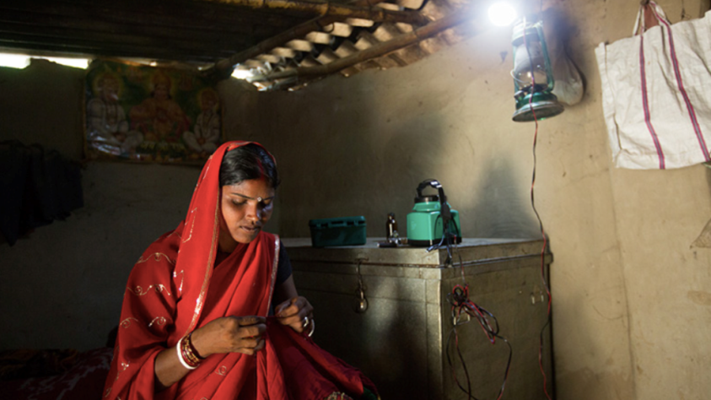
CASE STUDY : The Smart Power for Rural Development (SPRD) programme
Funded by The Rockefeller Foundation, the programme tests the potential of business models that deliver electricity through decentralised micro grids
The foundation fosters the creation of a shared value partnership ecosystem that strengthens the financial viability of ESCOs by:
electricity supply: helps promote adoption of best practices and subsidize initial start-up costs
electricity demand: develops demand generation strategies to convert rural businesses to renewables enabling environment: helps inform policies and regulations in India that impact the growth of the mini-grid market.
IMPACT IN 2 YEARS
SPRD has served approximately 6,000 households and 3,000 small businesses, providing lighting as well as productive loads
There are 95 operational SPRD mini-grids owned and operated by 7 ESCOs, serving more than 11,000 residential and commercial customers in Uttar Pradesh and Bihar
Uttar Pradesh launched the State Mini-grid policy, supporting implementation of decentralised micro grids in energy deficient regions.

Slide 12
SCALING UP IMPACT- towards a shared vision and global action agenda 2030
A shared vision:
LGEs as a pathway to building fair, green and resilient economies
LGEs as a pathway for delivering integrated poverty, environment and climate solutions for the SDGs
A global action agenda:
Shared objectives and strategic priorities for supporting and scaling up local green enterprise solutions
Towards a global multi-stakeholder partnership – The Declaration

Slide 13
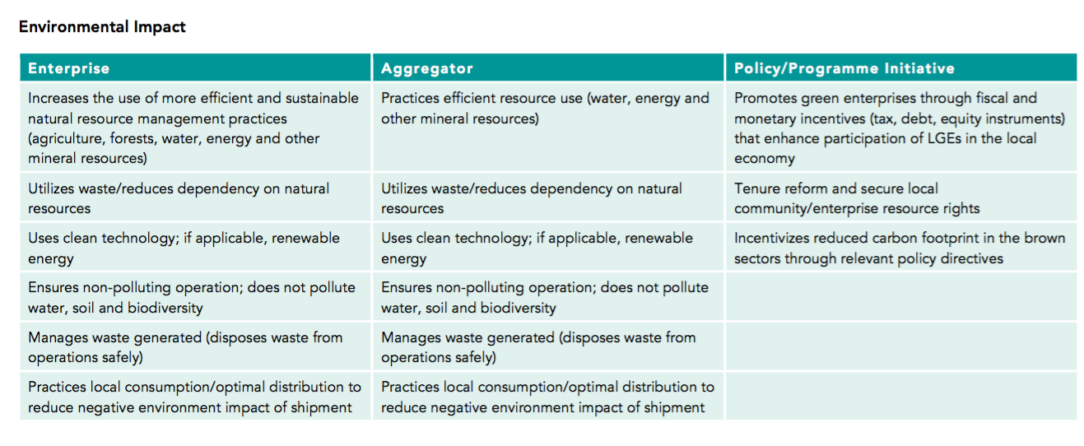
ASSESSMENT FRAMEWORK

Slide 14
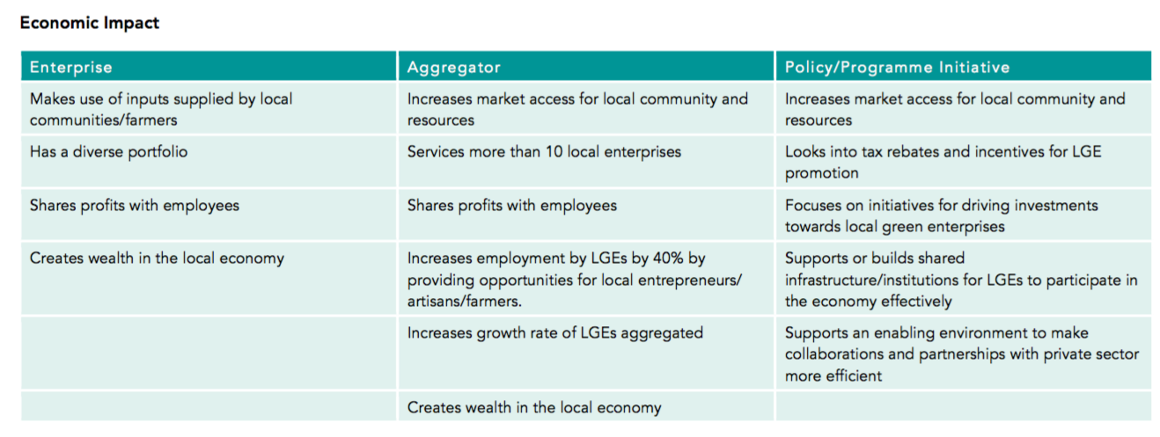
ASSESSMENT FRAMEWORK

Slide 15
LET’S DISCUSS!
Reflections on the framework : 15 Minutes
Elements of a shared vision : 10 Minutes
Processes for a global action agenda

