Slide 1

OECS GREEN ECONOMY …FAD or REALITY?

Slide 2

OECS GREEN ECONOMY DIAGNOSTIC REPORT (DRAFT)
EXPLORING OPPORTUNITIES FOR GREEN ECONOMY
TRANSFORMATION IN THE EASTERN CARIBBEAN

Slide 3

LITERATURE REVIEW
VAST AND VARIED

Slide 4
Green Economy Definitions
“aims for long-term prosperity, rather than solely for growth, through equitable distribution of economic benefits and effective management of ecological resources. It is economically viable and resilient to both external and internal shocks; self-directed and not driven by external agendas or funding opportunities, and self-reliant by being based predominantly on domestic production and investment. A Caribbean Green Economy is pro-poor and generates decent jobs and working conditions that offer opportunities for self-advancement for local people.”
Economic Wellbeing
Social Inclusion
Environmental Sustainability
Green Growth;
Climate Resilient
Low Carbon
Good Governance.

Slide 5


Triple Bottom Line
People – Social equity/inclusion
Planet- Climate/Ecology
$$ Profit – Jobs, livelihoods, income

Slide 6

0% Growth

Slide 7
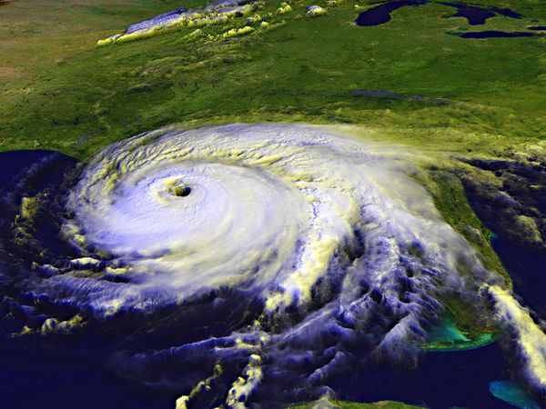
HURRICANES
Notes:
Keep the information short on your slides. The slides should be a reminder of what you are speaking about. The slides shouldn’t give the “game” away. If the audience can read everything you’re about to say than your job as a presenter is irrelevant. If you need the audience to take the information you speak about away with them, give them handouts at the end of the presentation instead of cramming all the information into your slides.

Slide 8

NEW
Notes:
Keep the information short on your slides. The slides should be a reminder of what you are speaking about. The slides shouldn’t give the “game” away. If the audience can read everything you’re about to say than your job as a presenter is irrelevant. If you need the audience to take the information you speak about away with them, give them handouts at the end of the presentation instead of cramming all the information into your slides.

Slide 9

The Collaborative Solution
Notes:
Keep the information short on your slides. The slides should be a reminder of what you are speaking about. The slides shouldn’t give the “game” away. If the audience can read everything you’re about to say than your job as a presenter is irrelevant. If you need the audience to take the information you speak about away with them, give them handouts at the end of the presentation instead of cramming all the information into your slides.

Slide 10



Pooling Resources & Expertise
CDB
CANARI
OECS

Slide 11
OPPORTUNITIES
FINANCE
GCF/AF
GREEN GROWTH
Public Finance
GREEN SECTORS
Agriculture
GE GREEN SHOOTS
Paris Agreement
Public Finance
CDB
World Bank
SGD
2030 Agenda
Private Investment
SWFs
Energy
Construction
Infrastructure
Tourism
Water supply
Fisheries
Housing
Waste Management
C-SERMS
Climate Resilience Fund: Post Hurricane

Slide 12
THE END…. Thank You

