Slide 1
Finance for a Green Economy
with Benoît Lallemand – Finance Watch
How can reforming the financial system help support the green economy?
How can finance help people around the world get a stake in the transition?
What should PAGE Ministers be prioritising on finance?

Slide 2
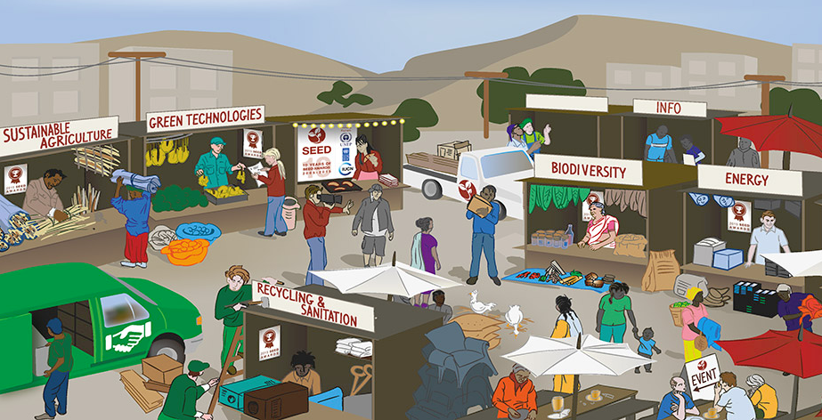
Small & Informal Business in a Green Economy
with Christine Meyer, Rest Kanju, and Rainer Agster – SEED
What policies can empower SMEs and informal business to be part of the green economy?
How can entrepreneurship help people get a stake in the transition?
What should PAGE Ministers be prioritising to support green SMEs?

Slide 3
Delivering Inclusion in a Green Economy
with Peter Poschen – University of Freiburg
Which policies are most important for making the transition to green economies as inclusive as possible?
What processes can help to ensure people get a stake in the transition?
What should PAGE Ministers be prioritising to deliver inclusion?

Slide 4
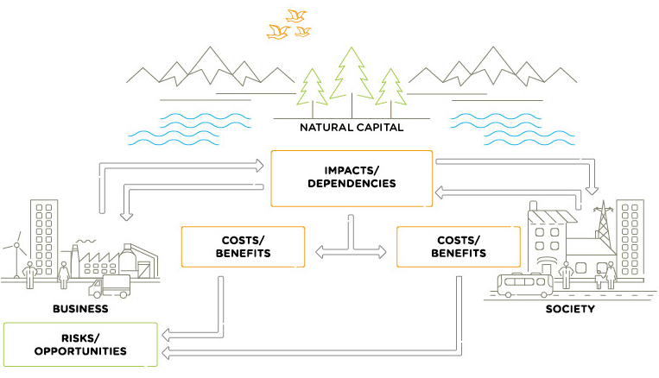
Natural Capital & Strategies for a Green Economy
with Mark Gough – Natural Capital Coalition
How can natural capital approaches and other strategies help deliver green economies?
How do these strategies make sure people get a stake in the transition?
What strategies should PAGE Ministers be prioritising?

